Slide 1

MaineHealth ACO
Maine Health Management Coalition
ACI Steering Committee
November 19, 2013

Slide 2
Agenda
MHACO structure
Background on decision to engage in MSSP
What did CMS require?
How did we meet that challenge?
What are we doing in commercial space?
Key learnings?

Slide 3
MHACO Structure

Slide 4
MaineHealth formed an ACO in 2011. The MMC PHO serves as the primary delivery network.
  Six of MaineHealth’s member hospitals capitalized the ACO
  The ACO Board has representation from physicians, hospitals and patients
  The MMCPHO is the implementing arm of the ACO, overseeing all operations
  The PHO network includes all MaineHealth hospitals,
  St. Mary’s Regional Medical Center, and over 1,200 physicians
MaineHealth
Member Hospitals
MaineHealth ACO, LLC
MMC PHO
Community Physicians of Maine
PHO Member Hospitals
Maine Mental Health Partners
MaineHealth Home Health Organizations
Skilled Nursing, Sub Acute Care, Other Key Partners

Slide 5
Why ACO? Why MSSP?

Slide 6
Why did MHACO decide to engage in MSSP?
MHACO wanted to be part of the solution and help to shape the future of health care
  By participating early, may be able to shape the approach
  Preparing for alternate payment model
  Moral imperative
We knew we had the building blocks and part of the foundation, but needed to start to build the structure
Offered and declined participation in the Pioneer model

Slide 7
MSSP overview

Slide 8
The Medicare Shared Savings Program focuses attention on 33 measures of quality & a financial target.
Arrangement | Payment Arrangement
Medicare Shared Savings Program | Shared savings through 2015 If we elect to continue beyond 2015 we must assume risk
Quality Metrics
33 Measures Strong focus on prevention and patient satisfaction Our eligibility for savings depends in part on our quality score Low scores result in a decrease in savings potential High score maximize what we earn back
“Loss” situation. ACO pays
back a portion to Medicare
“Savings” for Medicare
and the potential to
earn a portion back for
MaineHealth
Spending
Baseline
Period
Performance
Period

Slide 9
Beneficiary Eligibility and assignment
Eligibility
  Must have at least one month of both Part A and Part B enrollment
  Must have no months of Medicare Advantage enrollment
  Must have a primary care service with a physician within ACO
Assignment
  Step 1: One PCP service with PCP within the year
  Step 2: One PCP service with other ACO physician

Slide 10
Patient Notification Activities
All Medicare Shared Savings Program ACOs are required to notify patients that:
  Your provider(s) is participating in the MHACO
  Your provider(s) is eligible for additional Medicare payments or may be financially responsible to Medicare for failing to provide efficient, cost-effective care
  Medicare claims data for your patients may be shared with our ACO at the ACO’s request
  They can “Opt Out” of this data sharing by completing a form or calling 1-800-MEDICARE
    Currently <2% opt out

Slide 11
Patient Notification….
  Notification Methods:
    Letter to all patients- The MMC PHO mails Medicare Patients a letter with the required information
    Posters- ACO Participants must hang posters on site
    Point of Service notification at first patient visits

Slide 12


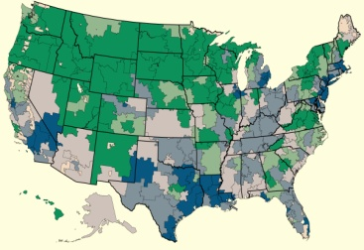
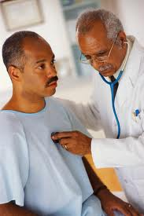
Our success as an ACO depends on excellence in four major areas.
Invest in Information for Patient Care and Population Health Successfully implement a shared medical record across our ACO AND harness the power of information for population health
Focus Care Coordination on Patients who Need it Most
MaineHealth will assess, consolidate and/or reorganize system-wide care coordination resources to ensure right focus on right patients
Establish a Culture of Learning and Transparency
A physician-led peer review program will focus on reducing unwarranted variation in care
Deliver on Primary Care
Implement the Medical Home model and ensure adequate supply of primary care for all ACO patients

Slide 13
Population health

Slide 14
MHACO must have ready answers to a new set of questions.
Who are the patients for whom we are accountable? Where do they receive their health care?
What are their clinical needs… and what does their care cost today?
Which patients are at highest current …. and future! … risk for poor clinical or financial outcomes?
Which patients have “gaps in care” – are they getting the care they need given their health condition?
Requires new and
different use of information
we already have :
Insight into all care received – not just what we provide ourselves
Marriage of clinical and financial data
Predictive modeling and financial / clinical risk analysis

Slide 15
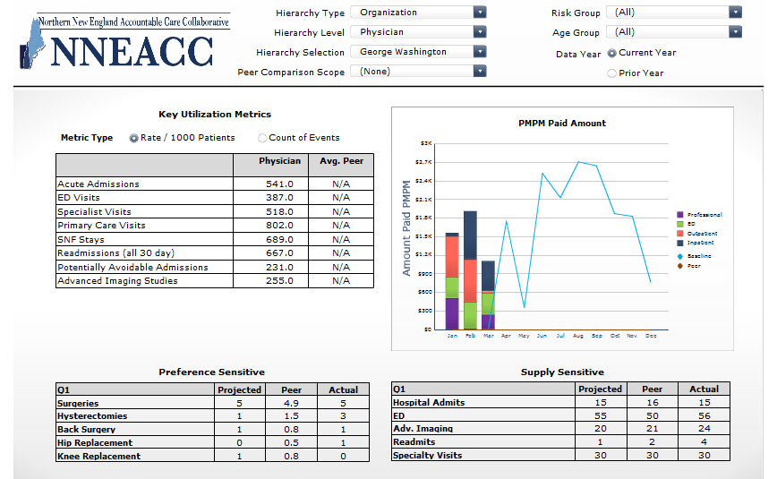
Utilization

Slide 16
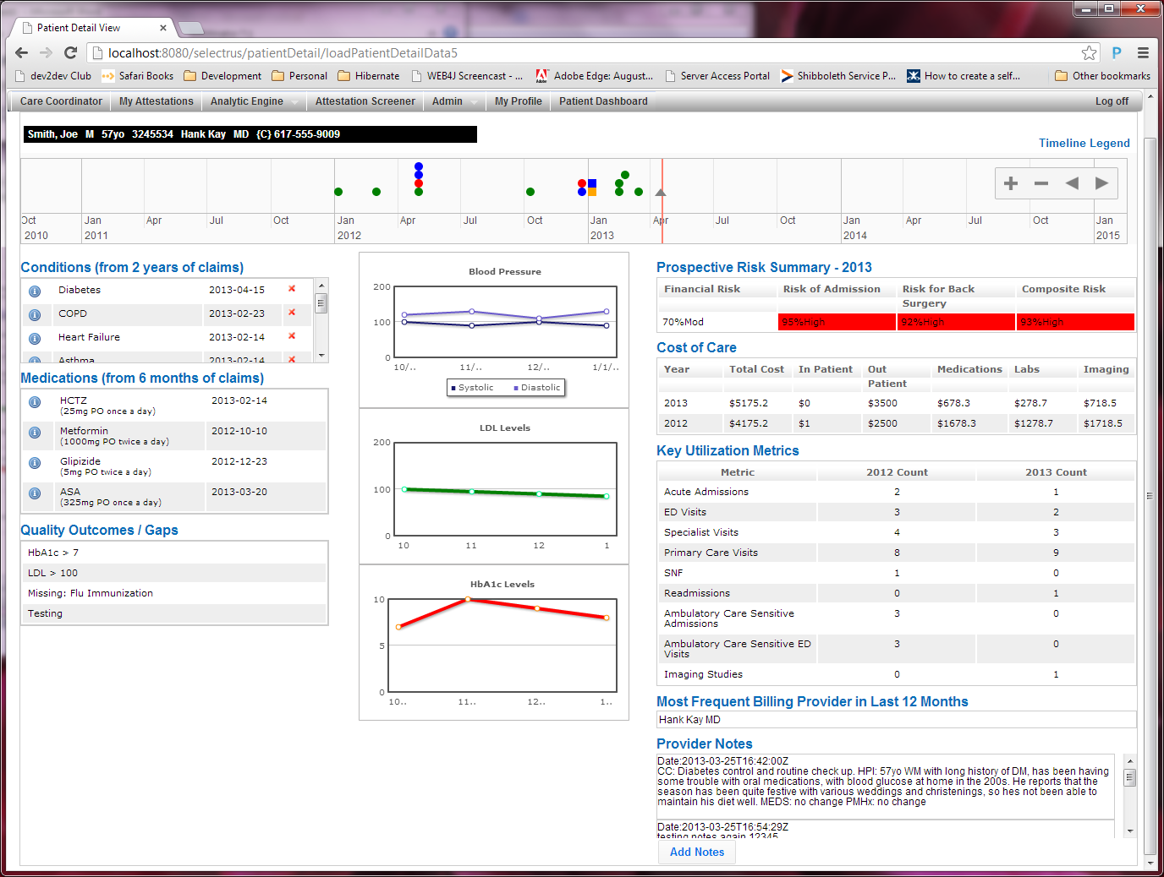
Dashboard overview

Slide 17
Care Coordination

Slide 18
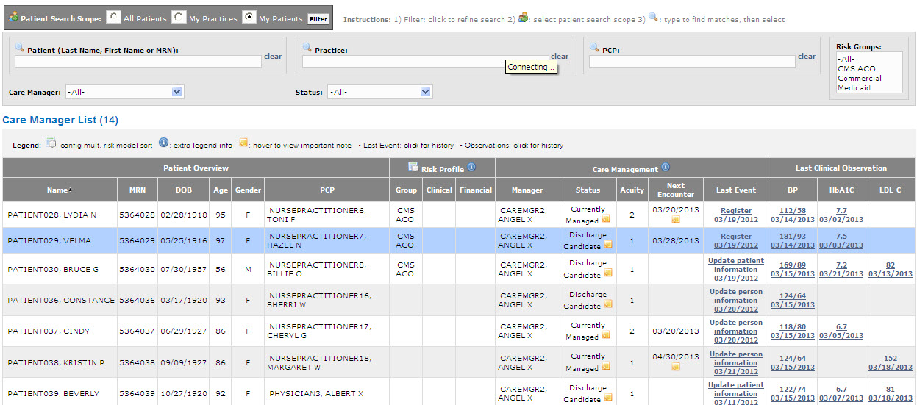
Risk stratification

Slide 19

Care Coordination
For all patients
For risk patients
Patient Population
Case Leads
  RN Care Manager
  SW Case Manager
  MH Case Manager
Additional Resources
  Health Guide
  Pharmacist
  Peer Advisor
  Interns / Students
Unique Referrals
Care Coordination Toolkit:
Communication Tools and Protocols
Provider Compacts
Co-management Agreements
Shared Plans of Care
Guides to Care and Referral
The Right
Complex Care Team
NNEACC
Identifi-cation of Complex Patients
CIR
Collaborations
  Home Health
  Agencies on Aging
  Embedded BH
  MMP CT
Site of Care Protocols
Central Navigation Team
EHRs
Patient Risk Level
Standardized Best
Practice
Interventions
Clinically Relevant Calibration
1. Data source algorithms will automatically export potential candidates for care management. | 2. Central Navigator uses all available information to assign appropriate case lead. | 3. Care Management team is gathered based on Central Navigator analysis. | 4. Team implements best practices to coordinate care.
Lateral Communication Exchange

Slide 20
Peer review process

Slide 21
The “Value Oversight Committee” is at the center of ACO value improvement.
MHACO Board
Support for Central and
Local Value Committees
MMC PHO Board
CPM Board
NNEACC
Benchmarking against other ACOs
Tool sets for Care Coordinators, Providers and Administrators
Ad-hoc reporting
Value Oversight Committee
Hospital/Physician team from each community
Annual identification of improvement priorities and ongoing review of challenges and variations in care
Oversight of corrective action / response plans
PHO Analytics
Follow-up analysis on benchmarks
Ongoing efforts to identify variation in care/outliers
Local Value Committees
System wide teams and ad hoc work groups: MH Clinical Integration, member organizations
Local Value Committees
Local Health Care Value Committees
Leverage / modify existing committees
Provide input and feedback on priorities
Develop local programs to address priorities and challenges

Slide 22
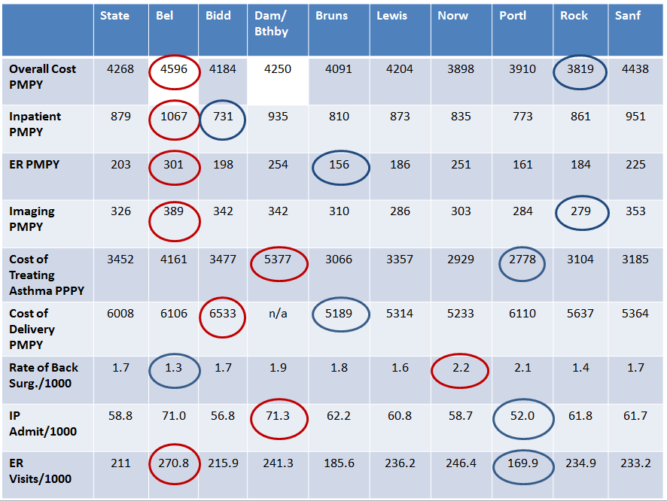

Slide 23
Primary care transformation

Slide 24
PCMH Activities
May 2012-Present
Convened PCMH Learning Collaboratives - Waves 1, 2 & 3
January 2013
Provided NCQA On Site Training “Facilitating PCMH Recognition” offered to all members
October 2013
Held PCMH Summit—Participants from all waves and senior leaders convene to continue collaboration, share learning
Trained: 29 practice teams (~150 participants) and 18 improvement coaches
Next Steps
Planning Wave 4 – Regional Collaborative for Waldo/PenBay Communities
July 2013
Targeted outreach to independent practices to determine PCMH readiness, offer support and assistance
Launched Wave 3 Collaborative

Slide 25
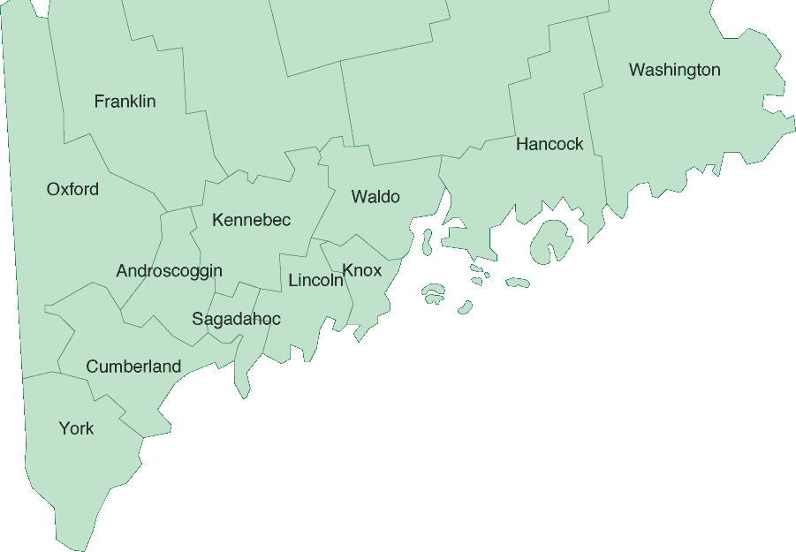
MHACO PCMH teams

Slide 26

NCQA Recognition Status
 | Primary Care Practices | Total NCQA Recognized | NCQA Recognition Pending (Application Submitted) | Projected 2013 YE
Owned & Affiliate | 73 | 33 (45%) | 7 | 40 (54%)
Independent | 42 | 3 (7%) | 2 | 5 (12%)
Total | 115 | 36 (31%) | 9 | 55 (38%)

Slide 27
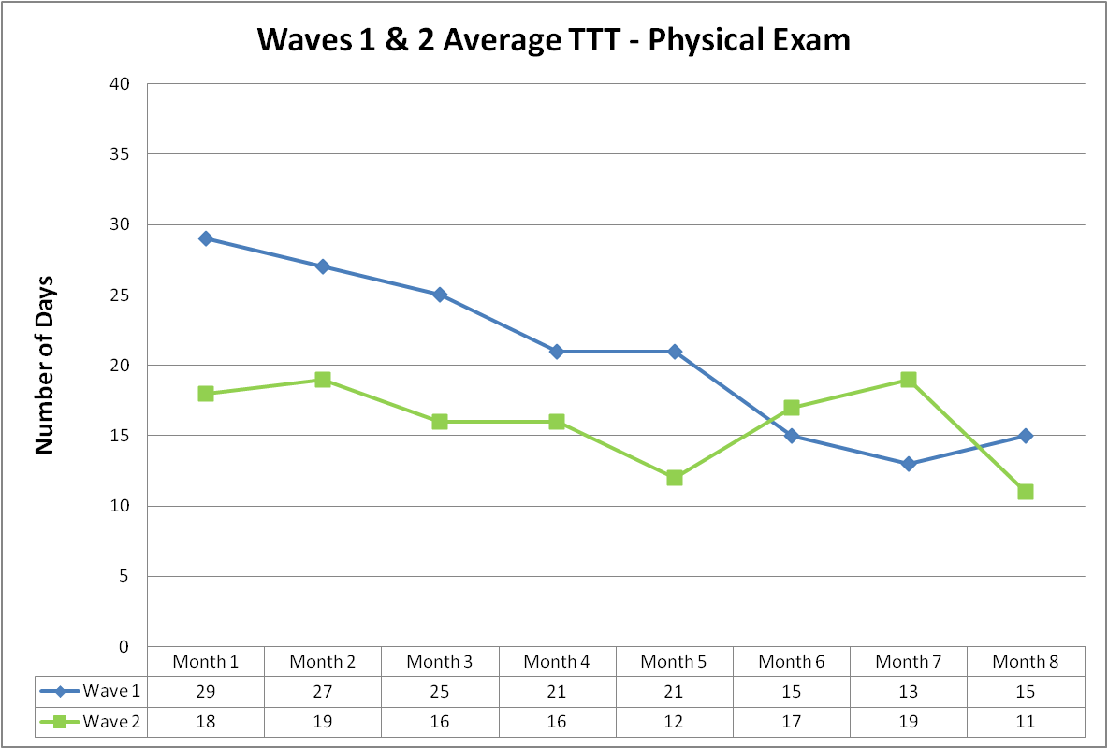
Improving Access:
Wave 1 & 2 Aggregate
Average Time to Third for an Annual Exam

Slide 28
Select Practice Accomplishments
Focus | From | To | % Improvement
Time to Third for Next Available Annual Exam | 40 days | 2 days | 95%↓
% of Patients 65> With Pneumonia Vaccine | 16% | 75% | 369% ↑
Weekly Exam Room Restocking Time | 90 min | 30 min | 67% ↓
% of Patients Receiving Tobacco Counseling | 38% | 70% | 84% ↑
% of Patient Receiving Healthy Habits Survey | 0% | 100% | 1000% ↑

Slide 29
Commercial ACO

Slide 30
Approximately 25,000 lives in commercial ACO agreements
Successes
Challenges
Good alignment with ACO measures
  Added pediatric and women’s health measures
Refining meeting structure to support
Timely and accurate data
  Attribution is tricky
Meeting demands for care coordination activities and associated reporting obligations
Expectations to do additional work without additional support to do so

Slide 31
Challenges / key learnings

Slide 32
Key Learnings and Challenges
Building the plane in the air
  Building blocks were there, but ….
Data, Data, Data
  Will never be perfect, but tells us enough
  End of Life as first initiative
  Focus on variations
Need to work toward a single process for all payers- current practice is not sustainable
Significant Administrative burden for practices
Practice diversity
Physician engagement is critical

Slide 33
Physician Engagement
Focus on the why?
How does ACO change day to day practice?
What is within their control?
  Guidelines, care coordination, using data for improvement, PCMH and neighborhood
Access to data is selling point for many
Busy practices- felt like one more thing
Challenge of employed vs. independent
Member Performance Review Program – raises the bar

Slide 34

It’s about culture change!!

